Slide 1
Explainable Machine Learning
2019, May 1st
2019 Flowcast Inc. | Confidential

Slide 2
Outline
Introduction to machine learning
Brief history of explainable machine learning
Why are they useful
Examples
How to generate explanations
Global
Local
Common pitfalls when generating explanations
Strategies to make them better

Slide 3
Introduction to Machine Learning
Machine learning approximates the world through evidence
At low dimensionality, it looks like simple curve fitting
Good generalizability is helpful to predict areas where data is sparse.
Overfitting is when the model fits to noise.
Hyperparameters are parameters of the model
Normally there are many inputs (features / dimensions) to a model (100s, 1000s, 10e4+)

Slide 4
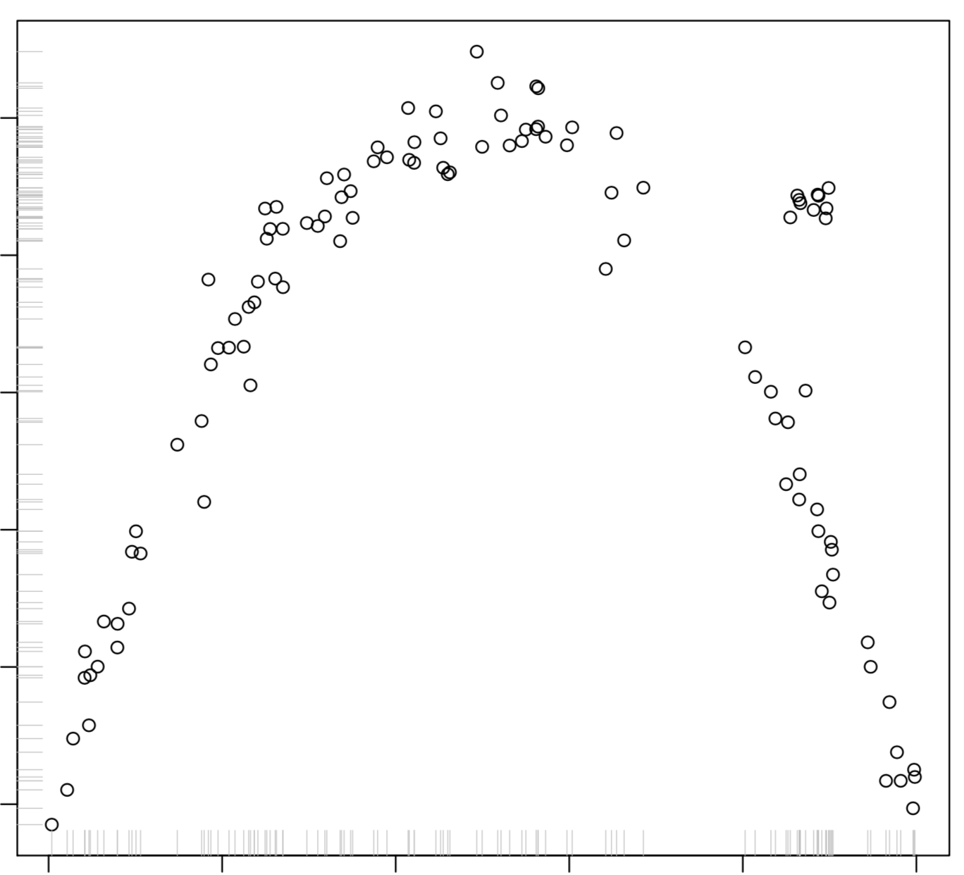
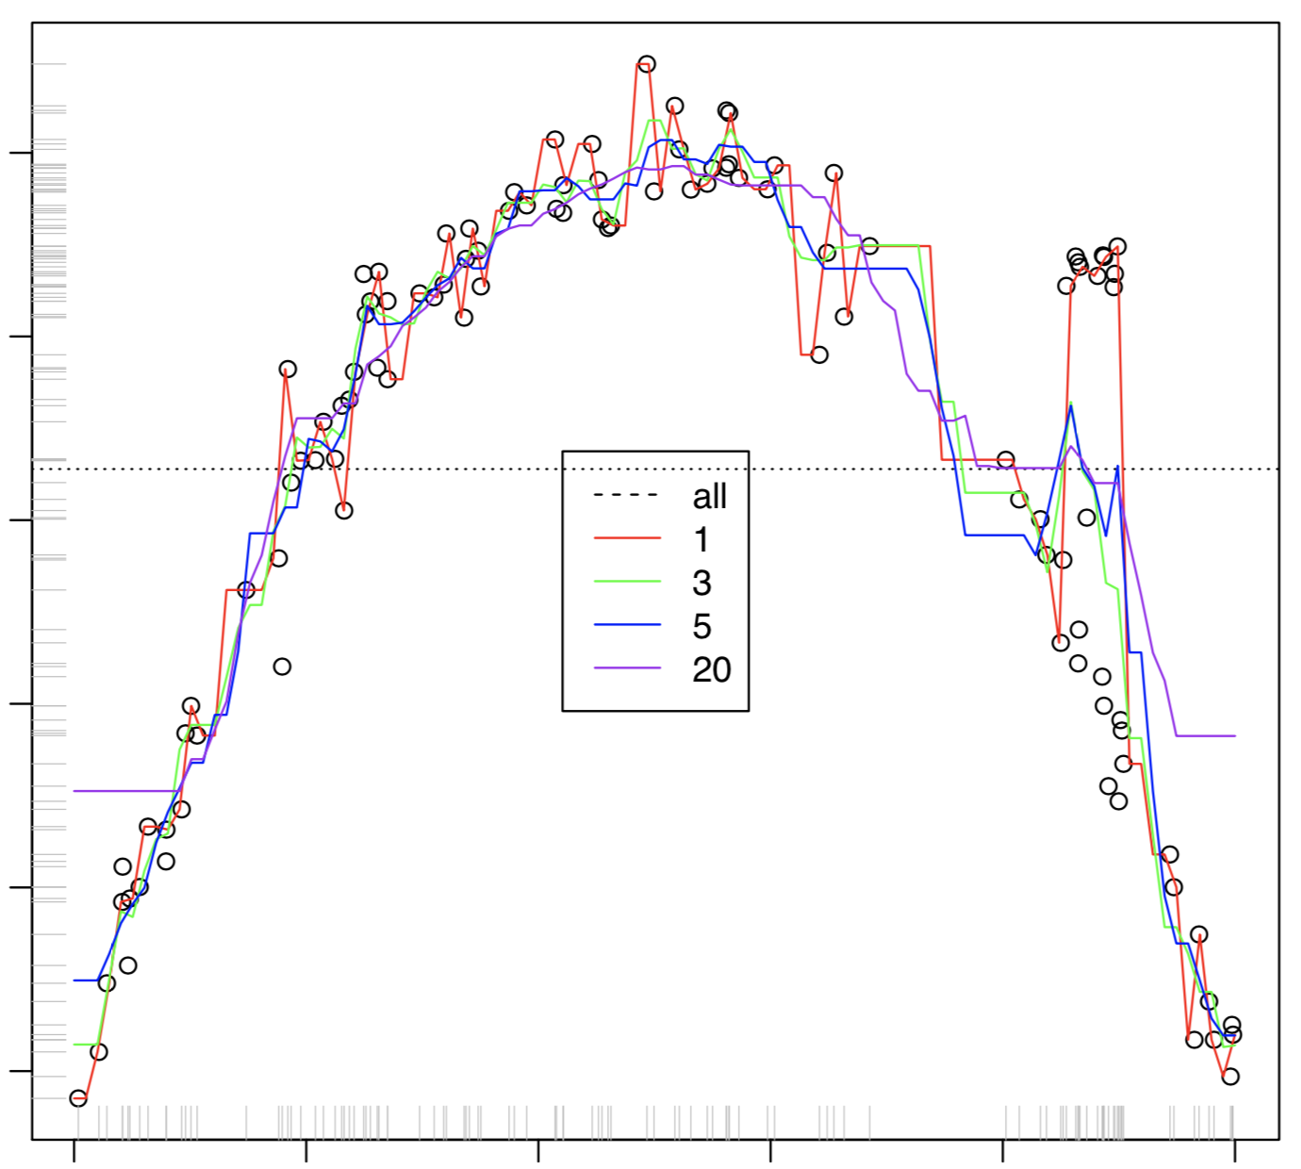
Introduction to Machine Learning
prediction
prediction
x
x
Cosma Rohilla Shalizi, Advanced Data Analysis from an Elementary Point of View, 2016 edition, pg 31 and 42
Notes:
“Machine learning” is generating predictions. Good generalization is able to predict in areas where data is sparse. Over-fitting is when the model fits to noise, as opposed to signal. Hyperparameters are parameters of the model

Slide 5
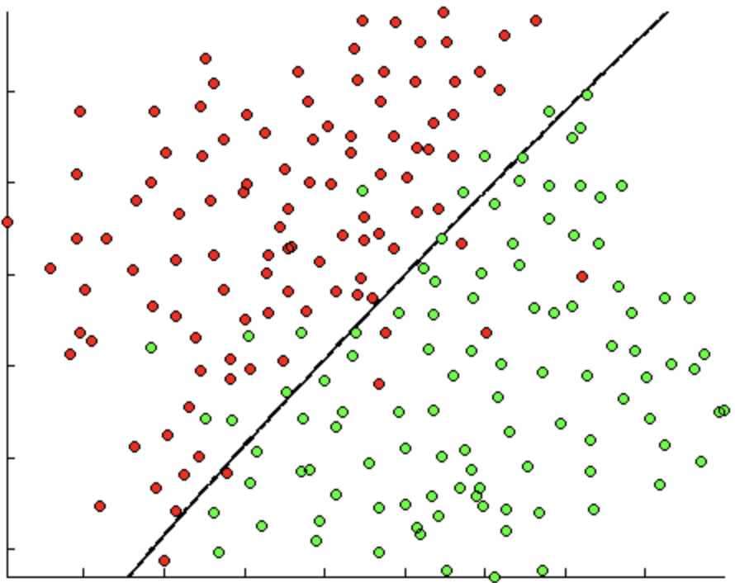
Machine Learning Classification
ML classification aims to segregate classes (decrease entropy)
Data Scientists’ aim with ML is to improve predictive power (usually)
Linear models are the least complex ML model (besides a simple average) complexity = (1 coefficient per dimension) + 1
Linear Boundary
Andrew Ng, OpenClassroom Machine Learning, Exercise 8, http://openclassroom.stanford.edu

Slide 6
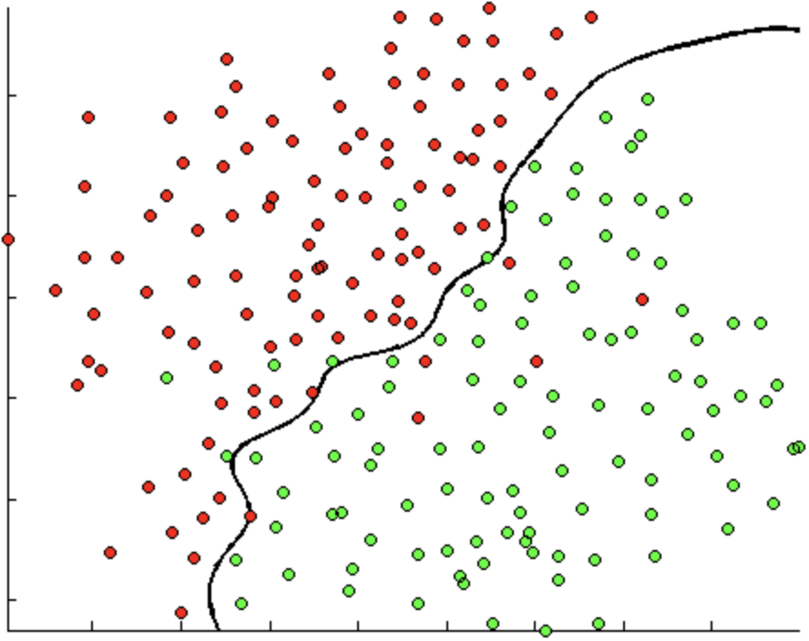
Machine Learning Classification
Non-linear Boundary
Non-linear models improve predictive power at the cost of increased complexity
Non-linear models are called “black-box models” in laymen’s
complexity = ( >>1 coefficient per dimension) + 1
Andrew Ng, OpenClassroom Machine Learning, Exercise 8, http://openclassroom.stanford.edu

Slide 7
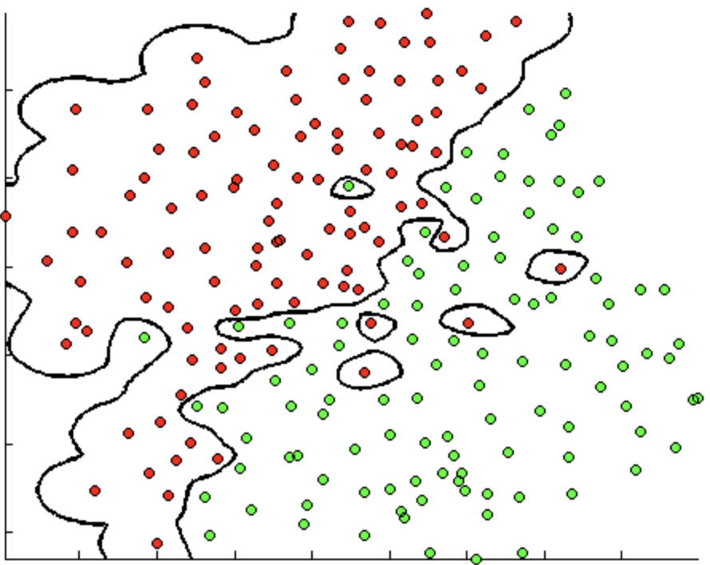
Machine Learning Classification
Non-linear Boundary
But can lead to overfitting, decreasing the predictive power.
On the training data, the cases are perfectly segregated. Will this generalize?
Andrew Ng, OpenClassroom Machine Learning, Exercise 8, http://openclassroom.stanford.edu

Slide 8
Machine Learning
Structured, numeric, non-null data matrix
ML Algorithm
________
________
________
________
________
Set of predictions
AlexNet (2012) (60M parameters)
256 x
256 x
3
= 196,608 input params
95% “greatest boy ever”
5%
“silliness”
A Krizhevsky, I Sutskever, GE Hinton - Advances in neural information processing systems, 2012

Slide 9
Why are explanations important?
Input data
(current vital signals)
Robot Doctor
Great!
________
________
________
________
________
________
ML Model
You’re going to die in the next 24 hours

Slide 10
Why are explanations important?
Input data
(current vital signals)
You’re going to die in the next 24 hours
Robot Doctor
________
________
________
________
________
________
ML Model
The top factors for the prediction are:
Heart rate = 140 bpm
Blood pressure = 170 over 110
Lower abdomen pain is True

Slide 11
Why are explanations important?
Input data
(current vital signals)
You’re going to die in the next 24 hours
Robot Doctor
________
________
________
________
________
________
ML Model
The top factors for the prediction are:
Heart rate = 140 bpm
Blood pressure = 170 over 110
Lower abdomen pain is True

Slide 12
Why are explanations important?
Our Explanation Requirements:
Reasons come from the inputs
Prediction is fixed
Model is fixed
Robot Doctor
You’re going to die in the next 24 hours
________
________
________
________
________
________
ML Model
The top factors for the prediction are:
Heart rate = 140 bpm
Blood pressure = 170 over 110
Lower abdomen pain is True

Slide 13
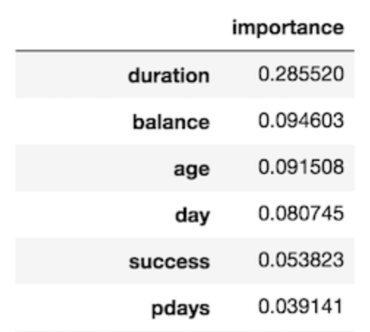
Global Explanations
Pros:
Fast, easy way to discover which features were impactful
Feature importance works with any tree-based ensemble model
Cons:
Not local

Slide 14
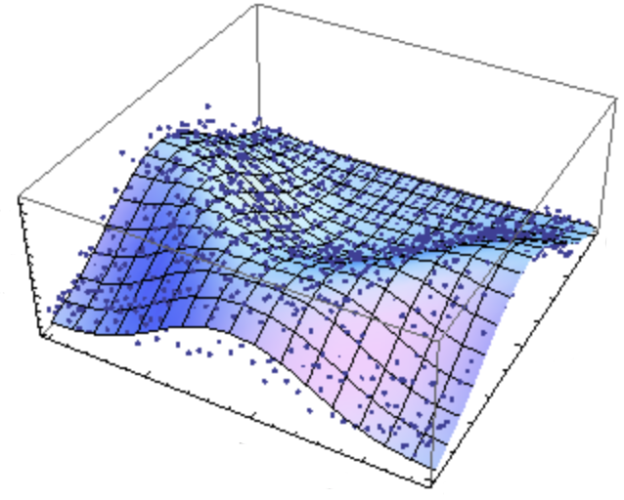
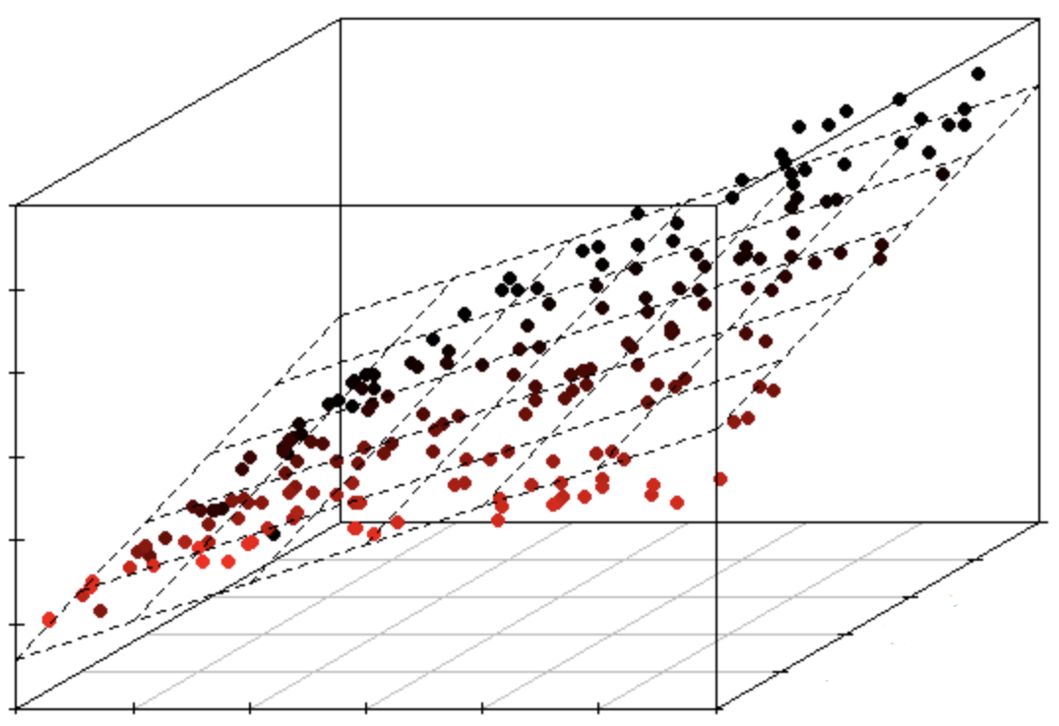
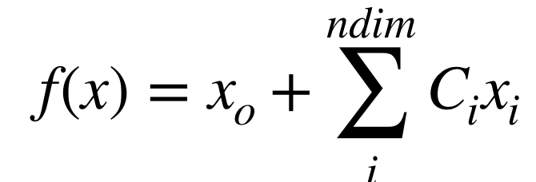
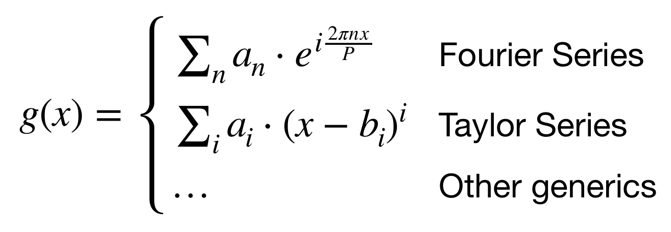
Local Explanations
Linear Model
Nonlinear Model
Feature impact is coefficient size (assuming normalized x_{i})
Explanations at each location in phase space is the same
Doesn’t capture dynamics of the data
Feature impact is the gradient of the model at the prediction
Explanations are different in different areas of feature phase space

Slide 15
Sensitivity Analysis
Normalize inputs
Vary each input a small amount at point of prediction along input x₁
Rank order by delta((abs(y))
prediction
x₁

Slide 16
Local Explanations
Nonlinear Model
Feature impact is the gradient of the model at the prediction
To first approximation, fit a linear model local to the prediction. This is what LIME does

Slide 17
LIME
Nonlinear Model
LIME is “Locally Interpretable Model Estimation”, or sampling data near a prediction and fitting a local linear model
It has a Python package!

Slide 18
LIME Demo
https://marcotcr.github.io/lime/tutorials/

Slide 19
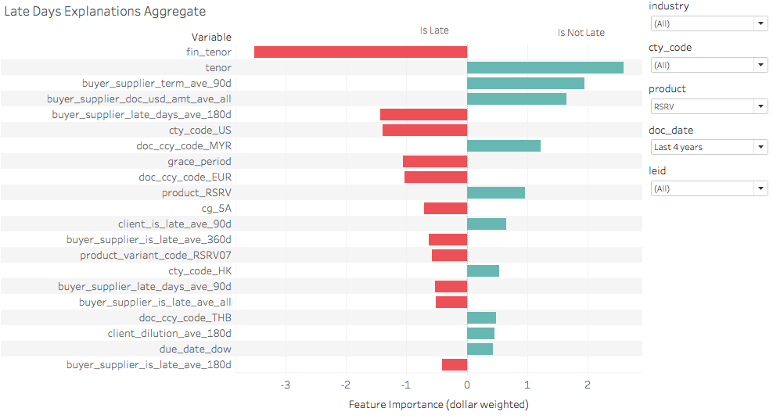
Beyond LIME
In practice, LIME output is hard to understand and read, even for professionals in the field
Correlated fields will bunch up in the explanations
How can we make this more intuitive?

Slide 20
Beyond LIME
Feature Explanation
Inputs to the model usually have some correlation. Sometimes more severe than others.
Correlations can occur in unexpected ways.
Correlated features can dilute the core feature importance.
salary_prev_5yr_avg
salary_prev_1yr_avg
salary_prev_1wk_avg
net_worth_prev_5yr_median
net_worth_prev_1yr_max
health_expenses_5yr_avg
health_expenses_6mo_avg
age
zip-code
Questions
Which features are most relevant?
Natural way to group features?
Will the relevancy change?

Slide 21
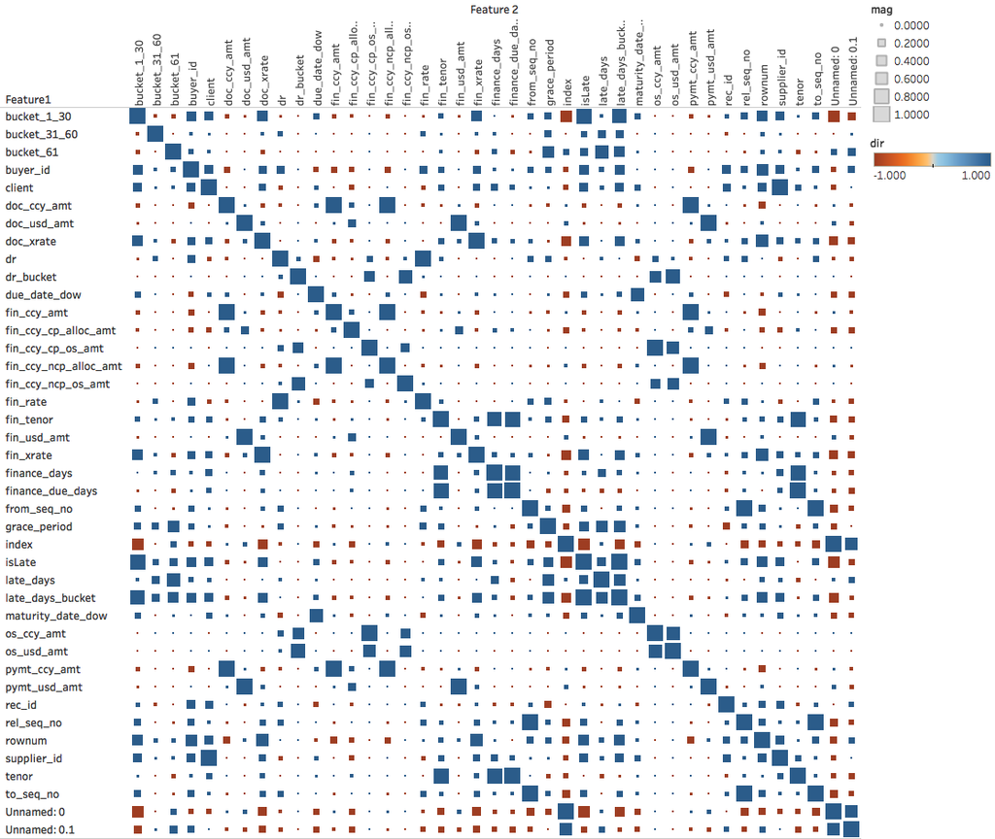
Beyond LIME
Group correlated (similar) features
Compute correlation matrix
Group features above a threshold abs(> 0.9)
Take cumulative feature impact from LIME

Slide 22
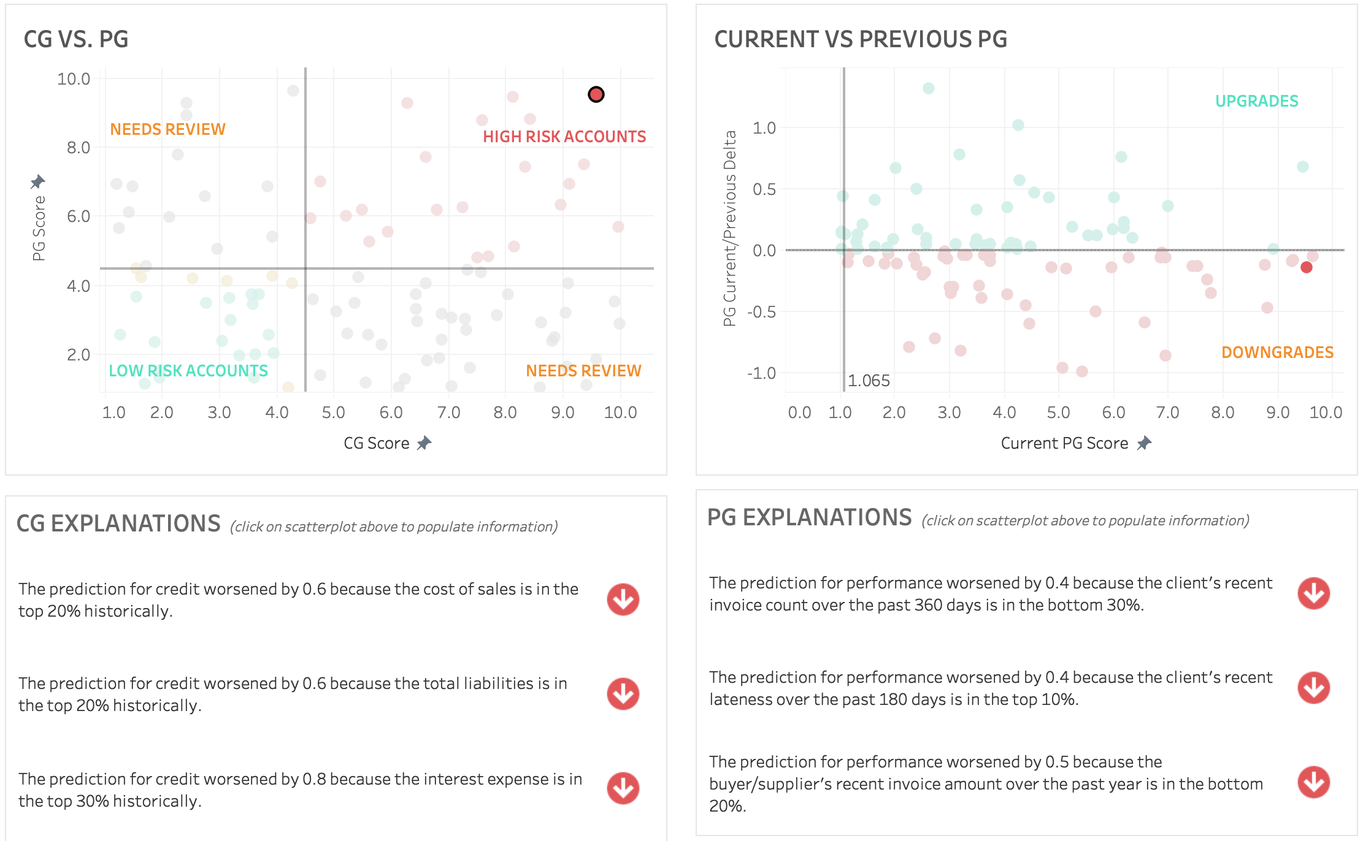
Beyond LIME
2) Comparison to peer group
Take the top N features output from LIME and compare the value vs. peer group.
3) Auto-generate sentences

Slide 23
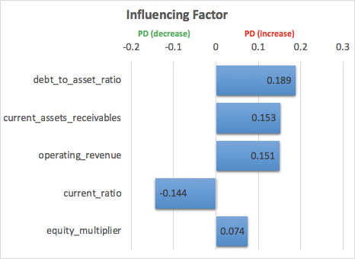
Example
Customer | Risk Bucket (1-low, 5-high) | Prob Default | Category
Customer A | 5 | 2.83% | High Risk
Actual Status: Default
Plain-text Explanation
The PD increased because the debt to asset is in the top 10th percentile compared to the peer group. The PD increased because the accounts receivable is in the bottom 10th percentile compared to the peer group. The PD increased because the total revenue is in the bottom 10th percentile compared to the peer group. The PD decreased because the current ratio is in the top 50th percentile compared to the peer group. The PD increased because the equity multiplier is in the top 10th percentile compared to the peer group.

Slide 24
Takeaways
Explainability is needed when root-cause analysis is critical to the machine-learning use-case.
Predictive models are usually non-linear, so other methods are needed to get explanations.
Intuitiveness is just as important as accuracy with regards to explanations.
Explainable machine learning is an open research field, so expect changes!

Slide 25
AI for Smarter Credit Decisions
Company Overview
Founded in San Francisco in 2015
Wholly-owned subsidiary in Singapore in 2018
Flowcast provides an AI solution to financial institutions to automate and power smarter credit decisions in order to unlock credit for the underserved SME market
Team
Strong team with deep domain expertise in corporate finance and AI/machine learning
Data Scientists with post-doc PhDs in Physics
Combined 15+ patents
Customers
In productions & pilots with Fortune 500, large global banks, and insurance providers
Technologies
Enterprise-grade AI platform to generate Machine Learning (ML) models that are fully explainable, transfer learning capable, and trained with over $500B+ in transactions
Daily invoice/dispute feeds for real-time predictive scoring
Three patents filed
Products
Smartcredit and Smartfraud are explainable ML solutions to provide predictive credit, performance, and fraud scores of businesses
SmartclaimsTM utilizes ML algorithms to automate deduction claims process, making it effortless to reclaim millions in cash leakage for customers
AI Engine
SMARTCREDIT
SMARTFRAUD
SMARTCLAIMS
2019 Confidential | Flowcast Inc.

Slide 26
Thanks!
We’re hiring! (SF office)
Python Software Engineer
Data Scientist
Data Engineer
Machine Learning Engineer
Please track me down after! Or email directly: eitan@flowcast.ai

Slide 27
Rate today ’s session
Session page on conference website
O’Reilly Events App

